Slide 1
Java PerformanceTuning

Slide 2
Java Memory Model

Slide 3
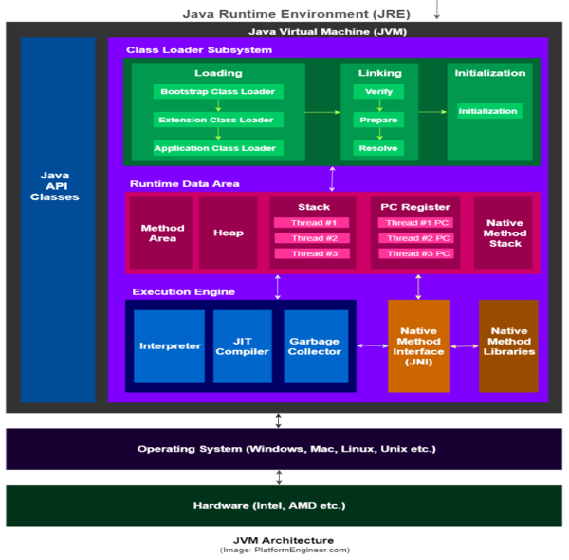
Java Runtime Environment

Slide 4
Memory model
The Java memory model specifies how the JVM works with the computer's memory (RAM).
The Java virtual machine is a model of a whole computer so this model naturally includes a memory model
Divided into
Heap
Method area
Stack area
…..etc

Slide 5
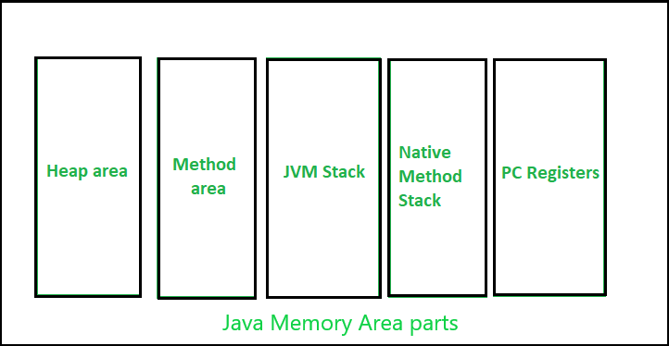
Memory model

Slide 6
Memory model
Heap:
shared runtime data area and stores the actual object in a memory
JVM provides the user control to initialize or vary the size of heap as per the requirement.
When a new keyword is used, object is assigned a space in heap, but the reference of the same exists onto the stack.
Stack:
A stack is created at the same time when a thread is created and is used to store data and partial results which will be needed while returning value for method
Stacks can either be of fixed or dynamic size. The size of a stack can be chosen independently when it is created

Slide 7
Memory model
Method area:
memory block that stores the class code, variable code(static variable, runtime constant), method code, and the constructor of a Java program.
It stores class-level data of every class such as the runtime constant pool, field and method data, the code for methods
Native Method stacks:
Also called as C stacks, native method stacks are not written in Java language
This memory is allocated for each thread when its created. And it can be of fixed or dynamic nature

Slide 8
Memory model
Program Counter:
Each JVM thread which carries out the task of a specific method has a program counter register associated with it
Cache Memory
This includes Code Cache
Stores compiled code (i.e. native code) generated by JIT compiler, JVM internal structures etc
When Code Cache exceeds a threshold, it gets flushed

Slide 9
Memory model - sample
class Emp {
int id;
String emp_name;
public Emp(int id, String emp_name) {
this.id = id;
this.emp_name = emp_name;
}
}
public class Emp_detail {
private static Emp Emp_detail(int id, String emp_name) {
return new Emp(id, emp_name);
}
public static void main(String[] args) {
int id = 21;
String name = "Maddy";
Emp person = null;
person = Emp_detail(id, name);
}
}

Slide 10
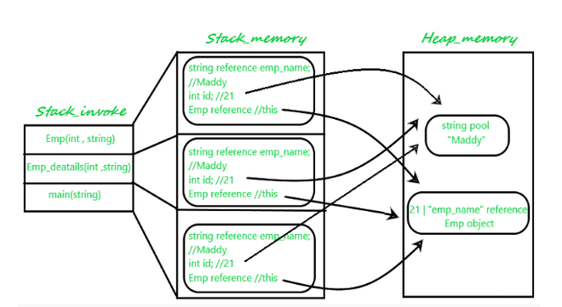
Memory model - sample

Slide 11
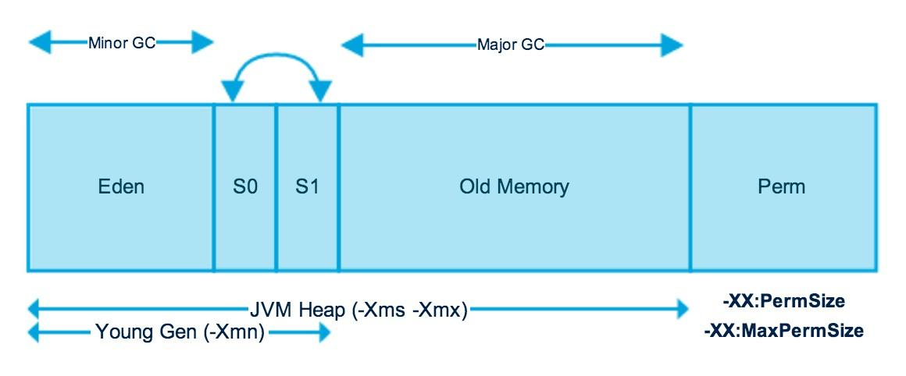
Heap Memory

Slide 12
Garbage Collection
The JVM heap is physically divided into two parts: nursery (young generation) and old space (or old generation)
The nursery is a part of the heap reserved for the allocation of new objects.
When the nursery becomes full, all the objects that have lived long enough in the nursery are promoted (moved) to the old space, thus freeing up the nursery for more object allocation
This garbage collection is called Minor GC.
The nursery is divided into three parts – Eden Memory and two Survivor Memory spaces
When old space is full, Major GC happens

Slide 13
Garbage Collection
Most of the newly created objects are located in the Eden Memory space
When Eden space is filled with objects, Minor GC is performed and all the survivor objects are moved to one of the survivor spaces
Minor GC also checks the survivor objects and moves them to the other survivor space.
So at a time, one of the survivor space is always empty
Objects that have survived many cycles of GC, are moved to the old generation memory space.
Usually, it is done by setting a threshold for the age of the nursery objects before they become eligible to promote to the old generation

Slide 14
SurvivorRatio
The SurvivorRatio parameter controls the size of the two survivor space
-XX:SurvivorRatio=6 sets the ratio between each survivor space and eden to be 1:6
If survivor spaces are too small, copying collection overflows directly into the old generation
If survivor spaces are too large, they will be empty
At each GC, the JVM determines the number of times an object can be copied before it is tenured, called the tenure threshold

Slide 15
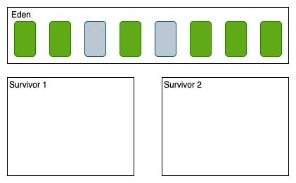
Garbage Collection
All new objects are created in Eden space
When the given space is full, the application tries to create another object and JVM tries to allocate something on the Eden but the allocation fails
That actually causes minor GC

Slide 16
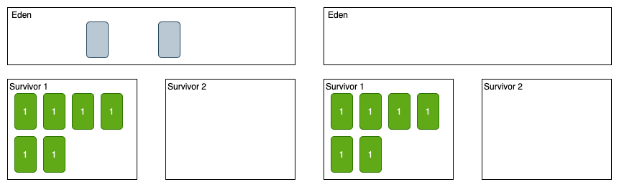
Garbage Collection
After the first minor GC, all live objects will be moved to Survivor 1 with the age is 1 and the dead objects will be deleted

Slide 17
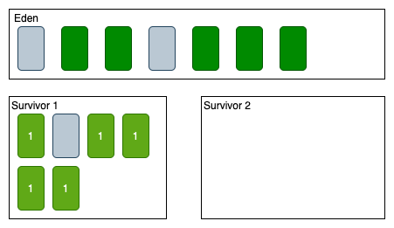
Garbage Collection
new objects get allocated in Eden space again. There are some objects that become unreachable on both Eden space and Survivor 1

Slide 18
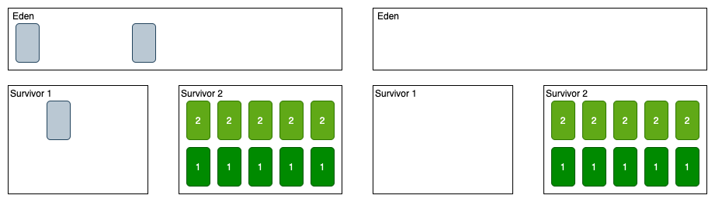
Garbage Collection
After the second Minor GC, all alive objects will be moved to Survivor 2 (from both Eden with age 1 and Survivor 1 with age 2) and the dead object will be deleted

Slide 19
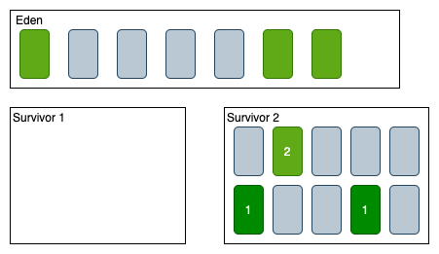
Garbage Collection
new objects are allocated on Eden space, after a few moments some objects are unreachable from both Eden and Survivor 2

Slide 20
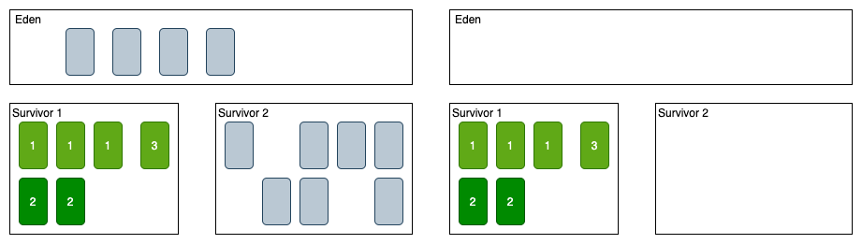
Garbage Collection
After the third minor GC, all live objects will be move from both Eden and Survivor 2 to Survivor 1 with age increase and dead objects will be deleted

Slide 21
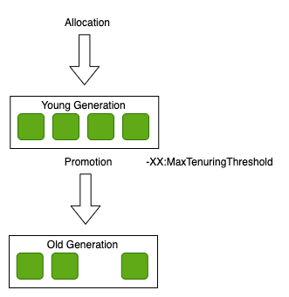
Garbage Collection
An object that is living longer in Survivor will be promoted to the old generation (Tuner) if the age is greater than -XX:MaxTenuringThreshold

Slide 22
MaxTenuringThreshold
When tuning the Java garbage collector (GC), 'survivor spaces' can be configured to "age" new objects.
The Java command line parameter -XX:MaxTenuringThreshold specifies for how many minor GC cycles an object will stay in the survivor spaces until it finally gets tenured into the old space Default value is 15. If a value greater than 15 is set, this now specifies that objects should never tenure and leads heap fragmentation
A fragmented heap cannot accommodate as many objects as a compacted heap

Slide 23
PermGen / Metaspace
Permanent Generation or “Perm Gen” contains the application metadata required by the JVM to describe the classes and methods used in the application.
Perm Gen is populated by JVM at runtime based on the classes used by the application.
Perm Gen also contains Java SE library classes and methods
With Java 8, Perm Gen is replaced by Metaspace which is not part of the heap
Most allocations of the class metadata are now allocated out of native memory.

Slide 24
PermGen / Metaspace (contd)
Metaspace by default auto increases its size (up to what the underlying OS provides), while Perm Gen always has fixed maximum size.
The theme behind the Metaspace is that the lifetime of classes and their metadata matches the lifetime of the class loaders.
That is, as long as the classloader is alive, the metadata remains alive in the Metaspace and can’t be freed.

Slide 25
Other structures
Method Area
Method Area is part of space in the Perm Gen and used to store class structure (runtime constants and static variables) and code for methods and constructors.
Memory Pool
Memory Pools are created by JVM memory managers to create a pool of immutable objects.
Memory Pool can belong to Heap or Perm Gen, depending on JVM memory manager implementation.

Slide 26
Other structures
Runtime Constant Pool
Runtime constant pool is a per-class runtime representation of a constant pool in a class. It contains class runtime constants and static methods.
Runtime constant pool is part of the method area.

Slide 27
Setting memory sizes
-Xms sets initial heap size
-Xmx sets maximum heap size
-XX:PermSize sets initial size of permgen
-XX:MaxPermSize sets maximum size of permgen
-XX:NewSize sets initial size of young generation
-XX:MaxNewSize sets max size of young generation
-XX:SurvivorRatio sets ratio of eaden space to survivor space
-XX:NewRatio sets ratio old space to new space
-XX:MetaspaceSize sets initial size of metaspace
-XX:MetaspaceSize sets max size of metaspace
-Xss sets the size of thread stack for each thread

Slide 28
Other JVM flags
-XX:MaxTenuringThreshold threshold for moving to old generation
-XX:+PrintGCDetails to display the settings and log
-XX:+PrintGCTimeStamps
-XX:+PrintGCDateStamps
-Xloggc:file to save the logs to a file
-verbose:gc

Slide 29
JVM flags - example
-Xms2560m
-Xmx2560m
-XX:NewSize=1536m
-XX:MaxNewSize=1536m
-XX:MetaspaceSize=768m
-XX:MaxMetaspaceSize=768m
-XX:MaxTenuringThreshold=5
-XX:SurvivorRatio=2

Slide 30
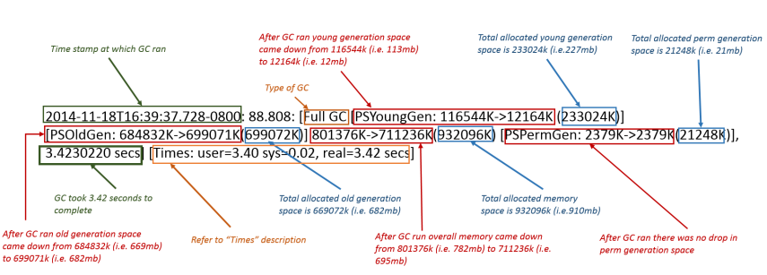
GC Logs

Slide 31
How Garbage Collector works
When an object is no longer used, the garbage collector reclaims the underlying memory and reuses it for future object allocation.
This means there is no explicit deletion and no memory is given back to the operating system
Special objects called garbage-collection roots (GC roots) are used to traverse the object graph to identify application-reachable objects
There are 4 kinds of GC Roots
Local variables
Active java threads
Static variables
JNI references

Slide 32
How Garbage Collector works(contd)
GC Roots
Local variables are kept alive by the stack of a thread.
For all intents and purposes, local variables are GC roots.
Active Java threads are always considered live objects and are therefore GC roots.
This is especially important for thread local variables.
Static variables are referenced by their classes and are GC Roots
Classes themselves can be garbage-collected, which would remove all referenced static variables (App server scenario)
JNI References are Java objects that the native code has created as part of a JNI call
Such objects represent a very special form of GC root

Slide 33
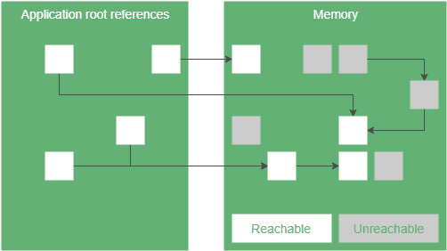
How Garbage Collector works (contd)

Slide 34
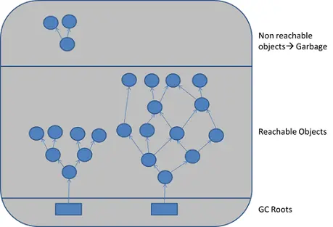
How Garbage Collector works (contd)
To determine which objects are no longer in use,
the JVM intermittently runs a mark-and-sweep algorithm
The algorithm traverses all object references, starting with the GC roots, and marks every object found as alive
All of the heap memory that is not occupied by marked objects is marked as free

Slide 35
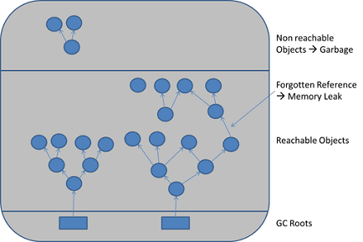
How Garbage Collector works (contd)
It's possible to have unused objects that are still reachable by an application because the developer simply forgot to dereference them
Such objects cannot be garbage-collected

Slide 36
Garbage Collection phases
Mark: garbage collector identifies which objects are in use and which ones are not
Sweep: after the marking phase has completed all space occupied by unvisited objects is considered free and can thus be reused to allocate new objects
Compact: after marking, move all marked – and thus alive – objects to the beginning of the memory region
Copy: similar to the Mark and Compact Here the marked objects are copied to different empty memory region.
Mark and Copy approach has some advantages as copying can occur simultaneously.
The disadvantage is the need for one more memory region, which should be large enough to accommodate survived objects

Slide 37
Types of Garbage Collectors
Serial Garbage Collector
This is the simplest GC implementation
it basically works with a single thread
As a result, this GC implementation freezes all application threads when it runs (stop the world)
It’s not a good idea to use it in multi-threaded applications, like server environments.
It is best suited for applications that don’t have small pause time requirements and run on client-style machines
Flag to select:
-XX:+UseSerialGC

Slide 38
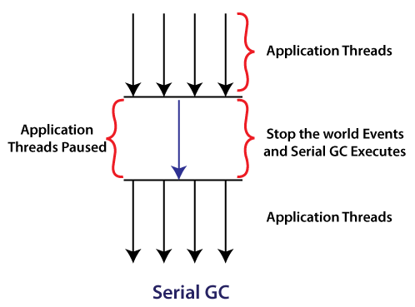
Types of Garbage Collectors
Serial Garbage Collector

Slide 39
Types of Garbage Collectors(contd)
Parallel Garbage Collector
Parallel Garbage Collector is the default GC used by the JVM.
The working of the parallel garbage collector is the same as the serial garbage collector
The only difference is that serial garbage collector uses a single thread and the parallel garbage collector uses multiple threads
The numbers of garbage collector threads can be controlled with the JVM option -XX:ParallelGCThreads=<N>
Flag to select:
-XX:+UseParallelGC

Slide 40
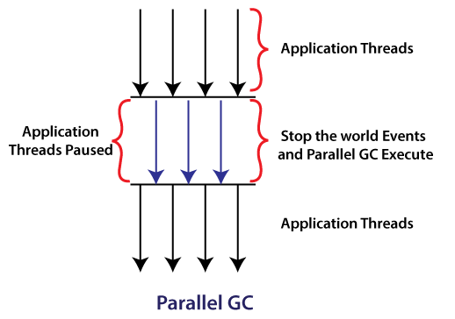
Types of Garbage Collectors(contd)
Parallel Garbage Collector

Slide 41
Types of Garbage Collectors(contd)
Parallel Old Garbage Collector
This is the same as Parallel GC except that it uses multiple threads for both young generation and old generation garbage collection
Flag to select:
-XX:+UseParallelOldGC

Slide 42
Types of Garbage Collectors(contd)
Concurrent mark sweep (CMS) Garbage Collector
CMS uses multiple threads to scan the heap memory consistently to the mark objects and then sweep the marked objects
It does not freeze the application's threads during the garbage collection
GC threads concurrently execute with the application's threads.
For this reason, it uses more CPU in comparison to other GC
Flag to select:
-XX:+UseConcMarkSweepGC

Slide 43
Types of Garbage Collectors(contd)
G1 (Garbage first) Garbage Collector
designed for applications running on multi-processor machines with large memory space.
It’s available from the JDK7 and in later releases.
G1 collector partitions the heap into a set of equal-sized heap regions,
After the mark phase is complete, G1 knows which regions are mostly empty
It collects in these areas first, which usually yields a significant amount of free space
Flag to select:
-XX:+UseG1GC

Slide 44
How to make the objects ready for GC
Create an object inside a method. After methods are executed, all objects called within those methods become unreachable
Nullify the reference variable. You can change a reference variable to NULL
Re-assign the reference variable. Instead of nullifying the reference variable, you can also reassign the reference to another object.
Create an anonymous object. An anonymous object doesn’t have a reference, so the garbage collector will mark and remove it during the next garbage collection cycle.

Slide 45
Best practices for GC
Choose the right garbage collector:
Monitor and analyze garbage collection logs:
Optimize heap size:
Tune garbage collection parameters:
Minimize object creation:
Use parallelism and concurrency:

Slide 46
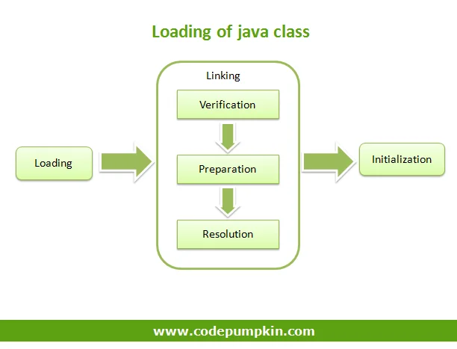
Class Loading Activities
Java’s dynamic class loading functionality is handled by the Class Loader SubSystem.
It loads, links and initializes the class when it refers to a class for the first time
Class Loader SubSystem is responsible for following 3 activities
Loading
Linking
Initialization

Slide 47
Loading
Loading means reading class files from hard disk and store corresponding binary data in method area.
For each class file JVM will store corresponding information in method area, such as
Fully qualified name of class
Fully qualified name of immediate parent class
Methods info
Variable info
Constructor info
Modifiers info
Constant pool info
whether .class file represents class or Interface or enum
After loading .class file JVM creates an object for that loaded class on the Heap memory of type java.lang.Class.

Slide 48
Linking
Linking consists of three activities
1. verify (verification)
Following points are checked in Verification process.
It ensures that Binary representation of a class is a structurally correct or not.
JVM will check
whether the .class file is generated by valid compiler
Whether .class file is properly formatted or not. (bytecode verifier)
If the binary representation of a class or interface does not satisfy the static or structural constraints then a VerifyError is thrown

Slide 49
Linking
2. prepare (preparation)
In this phase, JVM will allocate memory for class level or interface level static variables and assign default values.
3. resolve (resolution)
Resolution is the process of dynamically determining concrete values from symbolic references
it is the process of replacing symbolic names (variable names) with original memory references from method area

Slide 50
Initialization
In Initialization phase, all static variables are assigned with original values
static blocks will be executed from parent to child and from top to bottom.

Slide 51
Illustration
public class Test {
public static void main(String[] arg) {
String s = new String("Pumpkin");
Student s1 = new Student();
}
}
For the above class, class loader loads
Test.class
Object.class – parent class
String.class
Student.class

Slide 52
Types of Class Loaders
Class Loader Subsytem contains following three types of class Loaders
Bootstrap Class Loader or primordial Class Loader
Extension Class Loader
Application Class Loader or System Class Loader

Slide 53
Bootstrap Class Loader
It is responsible to load core Java API classes i.e. the classes present in rt.jar
This location is called bootstrap class path i.e. Bootstrap Class Loader is responsible to load classes from bootstrap class path.
Bootstrap Class Loader is by default available with every JVM.
It is implemented in native languages like C / C++ and not implemented in java.

Slide 54
Extension Class Loader
The extension class loader is a child of the bootstrap class loader, and takes care of loading the extensions of the standard core Java classes
The extension class loader loads from the JDK extensions directory, usually the $JAVA_HOME/lib/ext directory

Slide 55
System Class Loader
It is the child class of Extension Class Loader
This class loader is responsible to load classes from application class path
It internally uses environment variable classpath
It is implemented in java and the corresponding .class file name is sun.misc.Launcher$AppClassLoader.class

Slide 56
Class Loading Mechanism
Whenever JVM come across particular class, first it will check whether the corresponding .class file is loaded or not.
If it is already loaded in method area, then JVM will uses it
If it is not loaded then JVM request class loader sub system to load that particular class.
Then class loader subsystem hands over the request to Application class loader.
Application class loader delegates the request to Extension class loader
Extension class loader in turn delegates the request to Bootstrap class loader.

Slide 57
Class Loading Mechanism
Then Bootstrap class loader will search in Bootstrap class path and load it
If it is not available Bootstrap class loader delegates the request to Extension class loader.
Extension class loader will search in Extension class path and load the class
If not available, extension class loader delegates the request to application class loader.
Application class loader will search in Application class path.
If it is available, it will be loaded otherwise we will get runtime exception saying ClassNotFoundException.

Slide 58
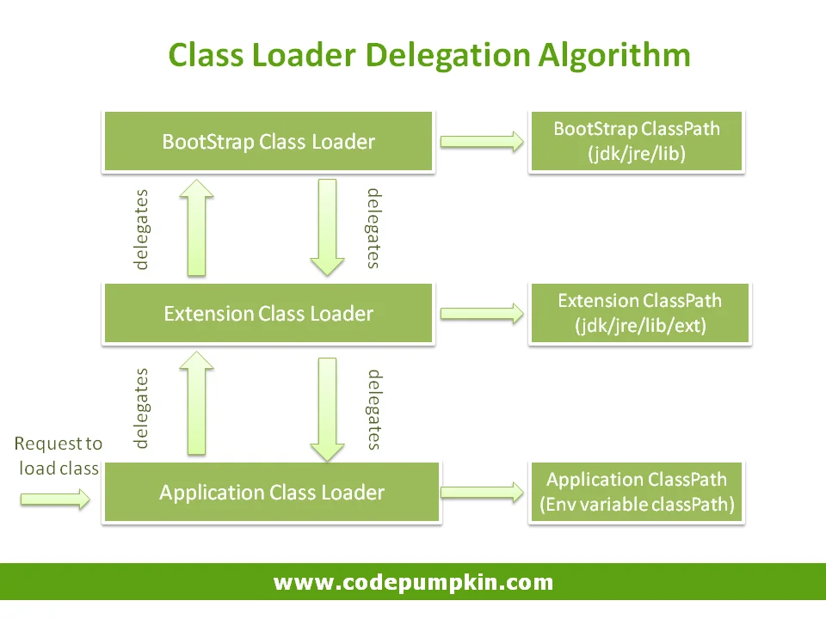
Class Loading Mechanism (contd)

Slide 59
Advantages
As a consequence of the delegation model, it’s easy to ensure unique classes, as we always try to delegate upwards.
For example if we create java.lan.String, it is never loaded
In addition, classes loaded by child class loader can use classes loaded by parent class loader
For instance, classes loaded by the system class loader can use classes loaded by the extension and bootstrap class loaders, but not vice-versa
To illustrate this, if Class A is loaded by the application class loader, and class B is loaded by the extensions class loader, then both A and B classes are visible as far as other classes loaded by the application class loader are concerned.
Class B, however, is the only class visible to other classes loaded by the extension class loader.

Slide 60
CustomClassLoaders
Custom class loaders are helpful for more than just loading the class during runtime.
A few use cases might include:
Helping to modify the existing bytecode
Creating classes dynamically suited to the user’s needs, e.g. in JDBC, switching between different driver implementations is done through dynamic class loading.
Implementing a class versioning mechanism while loading different bytecodes for classes with the same names and packages
Getting class code from network

Slide 61
CustomClassLoaders
Isolation: You want to load and unload plugins dynamically without affecting the main application. Custom class loaders enable isolation by loading each plugin in its own class loader.
Versioning: If you have different versions of a library in your application, custom class loaders can help you manage class versioning, ensuring that each component uses the appropriate version
Dynamic Loading: For situations where you want to load classes from sources other than JAR files, such as databases or remote services, custom class loaders are invaluable.

Slide 62
CustomClassLoaders
public class CustomClassLoader extends ClassLoader {
@Override
public Class findClass(String name) {
byte[] b = loadClassFromFile(name);
return defineClass(name, b, 0, b.length);
}
private byte[] loadClassFromFile(String fileName) {
}
}

Slide 63
Profilers
A Java Profiler is a tool that monitors operations at the JVM level
These code constructs and operations include object creation, thread executions, memory usage and garbage collections
Some known profilers:
Jprofiler
Yourkit
Java VisualVM
the NetBeans Profiler
the IntelliJ Profiler.

Slide 64
Memory Leaks

Slide 65
Class loaded multiple times
It is the very purpose of a classloader to load classes in isolation to each other
Application servers use this feature of classloaders to load different applications or parts of applications in isolation
This makes it possible to load multiple versions of the same library for different applications.
Due to configuration errors, we can easily load the same version of a library multiple times
Make sure you do not have too many class loaders

Slide 66
Class loader leaks
As classes are referenced by their classloaders,
they get removed when the classloader is garbage-collected.
That will happen only when the application gets unloaded
A classloader will be removed by the garbage collector only if nothing else refers to it.
All classes hold a reference to their classloader and all objects hold references to their classes.
As a result, if an application gets unloaded but one of its objects is still being held (e.g., by a cache or a thread-local variable), the underlying classloader is not removed by the garbage collector
This will happen only if you redeploy your application without restarting the application server

Slide 67
Mutable static fields
Static fields are de facto GC roots, which means they are never garbage-collected!
For convenience alone, static fields and collections are often used to hold caches or share state across threads.
Mutable static fields need to be cleaned up explicitly.
The cleanup will not take place, resulting in a memory leak.
Never use mutable static fields—use only constants.
If you need mutable static fields, make sure of tracking them or try some other technique

Slide 68
JNI Memory Leaks
Java Native Interface (JNI) memory leaks are hard to find.
Every Java object created in a native method begins its life as a local reference,
which means that the object is referenced until the native method returns.
In some cases you want to keep the created object even after the native call has ended.
To achieve this you can either ensure that it is referenced by some other Java object or you can change the local reference into a global reference
The only way to discover JNI memory leaks is to use a heap-dump tool that explicitly marks native references.
It's better to assign the desired object to the field of a normal Java class.

Slide 69
ThreadLocal Variables
ThreadLocal is a feature that enables the creation of thread-specific variables.
Unlike regular variables that are shared across threads, a ThreadLocal variable provides each thread with its own, independent copy.
This is particularly useful in multi-threading environments where data isolation per thread is required
ThreadLocal initializes the variable the first time a thread accesses it, using an initialValue method.
The thread can then set or get this variable’s value throughout its execution

Slide 70
Thread Pool
The Thread Pool pattern helps to save resources in a multithreaded application and to contain the parallelism in certain predefined limits
When we use a thread pool, we write our concurrent code in the form of tasks and submit them for execution to an instance of a thread pool.
This instance controls several re-used threads for executing these tasks

Slide 71
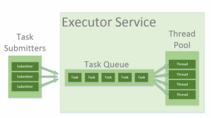
Thread Pool

Slide 72
ThreadLocal in Thread Pool
the application borrows a thread from the pool.
Then it stores some thread-confined values into the current thread’s ThreadLocal.
Once the current execution finishes, the application returns the borrowed thread to the pool.
After a while, the application borrows the same thread to process another request.
Since the application didn’t perform the necessary cleanups last time, it may re-use the same ThreadLocal data for the new request.
This may cause surprising consequences in highly concurrent applications.

Slide 73
ThreadLocal Memoy Leaks
ThreadLocals are supposed to be garbage collected once the holding thread is no longer alive.
But the problem arises when we use ThreadLocals in Thread pools
Modern application servers use a pool of threads to process requests, instead of creating new ones
If any class creates a ThreadLocal variable, but doesn’t explicitly remove it, then a copy of that object will remain with the worker Thread
ThreadLocals provide the remove() method, which removes the current thread’s value for this variable

Slide 74
Problem with large classes
At times it is possible to have a class with lot of static variables and methods
These classes occupy lot of memory
Split these classes into smaller classes so that only those classes which are being used remain in the memory and the other classes are unloaded when not used

Slide 75
Coding Techniques

Slide 76
Understanding Collections
Interface | Class | Synchronized?
Set | HashSet | No | Fastest Set; slower than HashMap but implements the Set interface (HashMap does not)
 | TreeSet | No | Slower than HashSet; provides iteration of keys in order
Map | HashMap | No | Fastest Map
 | Hashtable | Yes | Slower than HashMap, but faster than synchronized HashMap
 | TreeMap | No | Slower than Hashtable and HashMap; provides iteration of keys in order
List | ArrayList | No | Fastest List

Slide 77
Optimize the code
Understand String class
Understand StringBuilder and StringBuffer classes
Use regex for string complex comparisons
Avoid BigInteger and BigDecimal
Avoid large methods
Avoid large classes (split them)
Understand primitives vs Wrappers
Database connection pooling
Use PreparedStatement instead of Statement in JDBC

Slide 78
JDBC Statement
The JDBC Statement class has a few flaws
Statement st = con.createStatement();
String username = “ramana"; // user input
String query = "SELECT user FROM users WHERE name = '" + username + "'";
ResultSet result = st.executeQuery(query);
If the user were to pass ‘ OR 1=1– the resulting query would become:
SELECT user FROM users WHERE username = '' OR 1=1 -- ‘
This would cause the query to return all records since the OR 1=1 condition is always true.
The double dash — at the end is a comment in SQL, which causes the rest of the original query to be ignored.
This type of attack is called SQL Injection.

Slide 79
Logging
Before you create a debug message, you should always check the current log level first.
Otherwise, you might create a String with your log message that will be ignored afterward
The following code builds a string which may not be used log.debug(String.format(“User [%s] called method X with [%d]”, userName, i));
It’s better to check the current log level first before you create the debug message.
if (log.isDebugEnabled()) { log.debug(“User [” + userName + “] called method X with [” + i + “]”); }

Slide 80
Recursion
Recursion is good in solving complex problems where loops cannot be used
However, you should use recursion sparingly
In the iterative approach, the local variables are created once.
However, in the case of the recursion, for each method call a stack frame with local variables is created.
The rule is – do not use recursion if loops can be used

Slide 81
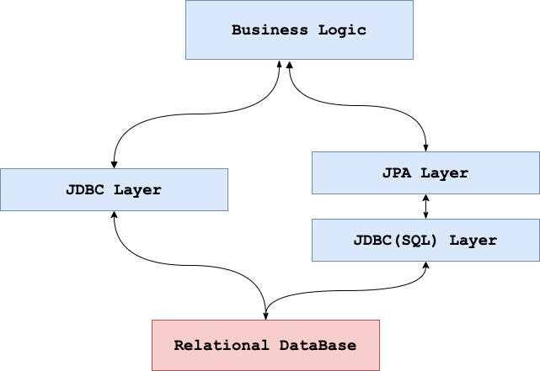
Is JPA preferable to JDBC
JPA is a Java standard for binding Java objects to records in a relational database
Handling object persistence is breeze with JPA
But for simple operations JPA has its own overhead

Slide 82
Optimize SQL queries
Add missing indexes
Use indexes effectively
Check for unused indexes
Reduce the use of wildcard characters
Use wildcards at the end of a phrase only
Use appropriate data types and layouts
Avoid redundant or unnecessary data retrieval
use exists() instead of count()
Avoid subqueries (join may be better)
Avoid too many JOINs
Avoid using SELECT DISTINCT
Use SELECT fields instead of SELECT *
Minimize large write operations
Create joins with INNER JOIN (not WHERE)

